Slide 1
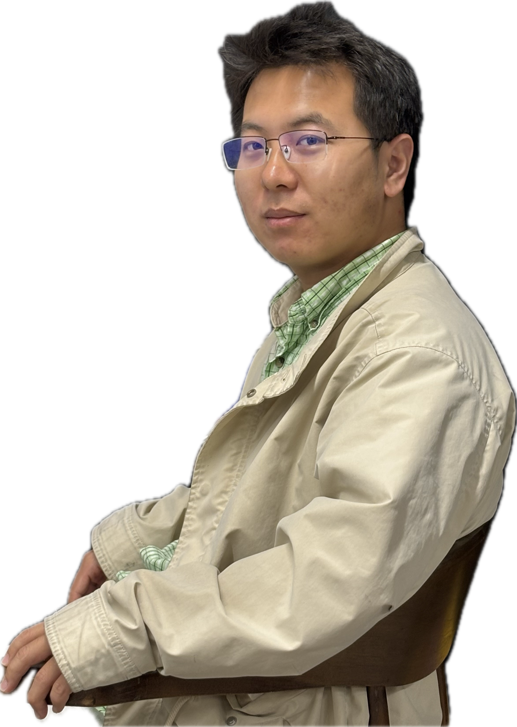
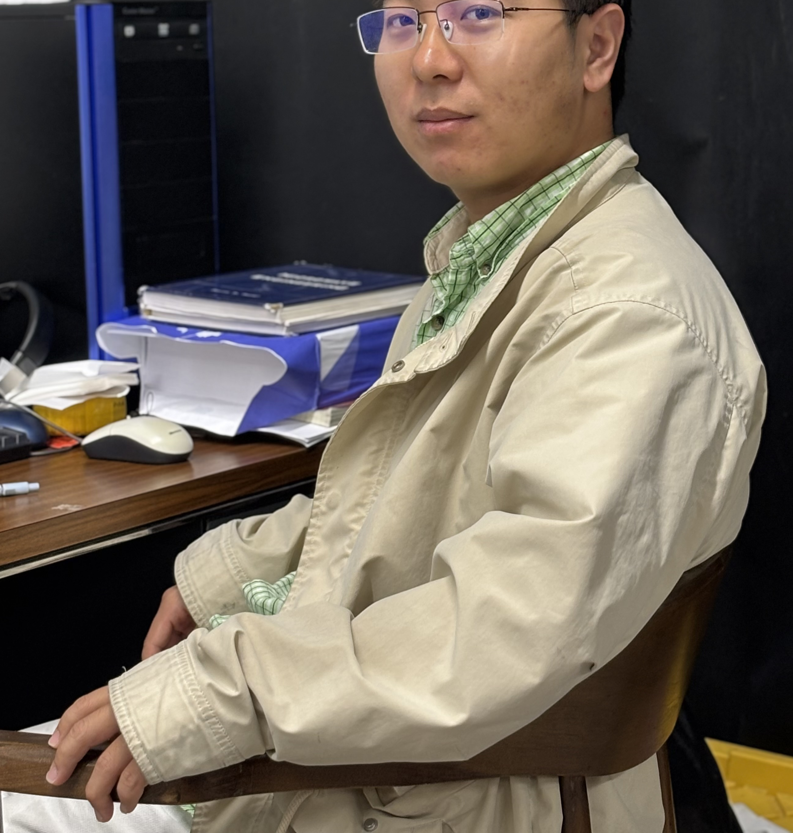
Programming and Automation
Programmer Xinhang
Programming and Automation

